Slide 1


Police Operations After Ferguson
Brought to you by:
Attorney Eric Daigle
DAIGLE LAW GROUP
And
Attorney Eric Atstupenas
ATSTUPENAS LAW OFFICE
Notes:
The manner in which we will do this is to give you a review of the DOJ report.

Slide 2

Investigation of the
Ferguson Police Department
On March 4, 2015, the Department of Justice (DOJ) released a 102-page report containing its findings from its investigation into the Ferguson Police Department.
Notes:
Issued recommendations for Ferguson PD. What I want to make clear is that in no way are we analyzing the truth or veracity of the information contained in the report specific to the Ferguson PD. In no way are we saying whether Ferguson was right or wrong because the reality is, while you and I think we may have some information on that, we do not have the ability to comment on that. So the one thing we are not doing is determining whether the findings were appropriate. The purpose of this presentation is to insure that what you take from this report is a guiding factor.

Slide 3
Summary
The release of this report has brought about a flood of attention from countless venues. Everyone from media, to legal experts and political analysts, and even the President of the United States has weighed in on the report.
The report has been called “shocking,” “damning,” “scorching,” and “scathing,” containing “outrageous examples of police misconduct.”
Whichever adjective is attached to this report, there is no doubt that the findings and recommendations contained therein will have a devastating effect on the City of Ferguson.
Notes:
So what is the self analysis I want you to take away from this? When this report was released there was a lot of emotion attached to it. I have an opinion as of course many of your already know. But lets take the report for what it is and that is a guiding document issued by the DOJ to FPD about the things they should correct.

Slide 4
Recommendation
Using this report of DOJ and POTUS Task Force - police departments can take this opportunity to utilize the DOJ’s investigative process and recommendations, as a tool to conduct a self-examination into their own department’s practices and procedures, and create a blueprint by which to improve their own department operations.
Self-Examination have been recommended by the POTUS Task Force & the DOJ.
Notes:
I know your not going to read 102 pages so we tried to break this down into a more manageable document. I know that Eric has broken this report down into a 6 page document which he sent out previously. Specifically one of the questions is: is this a blueprint? Now I would recommend that you take this report along with the findings by the POTUS task force and sit down with your command staff and take the opportunity to utilize the DOJ’s process, findings etc. to do its own self-audit. Our philosophy is that we want you all to be the best projected that you can. We want the officers to have the right tools, philosophy and methodology to do the best possible job that they can. What we notice nationwide, however, is that it is difficult to get agencies to self-examine. In fact, self-examinations have been recommended by both the POTUS TF and the DOJ Report. So yes, I suppose that this is a blueprint. So after covering what we will cover today, I want you to ask yourself, where do we stand with respect to these topics? How can this apply to us and our policies, training, supervision, etc.?

Slide 5
Is Ferguson a Blueprint?
It is not feasible within the confines of this training to discuss all of the issues and recommendations contained in the lengthy Ferguson report.
Rather, we will focus on those areas in the report that seem to garner the most attention in investigations of this sort, and those areas in which many departments often find a need for improvement.
Limited to a brief discussion of the following: bias based policing, use of force reporting and investigations, proper supervision, accepting and investigating complaints of misconduct, training, and community policing.
The purpose of this training is not to opine on the accuracy of the DOJ’s investigation and assessment. Rather, it is a review of the DOJ’s findings and recommendations contained in its report.
Notes:
What is concerning, particularly in the area of defense litigation is that let’s not forget that once this stuff gets put out there, it becomes a factor for plaintiff’s attorneys. We will discuss how plaintiff’s attorneys can use this to meet the requirements for a Monell claim and then we will start seeing attorneys will start asking certain basic questions in order to make the argument in court that you are not keeping up with current issues and trends. Now it is not feasible within this context to touch upon all of these issues and I could do a whole seminar on each one of these issues. I just want to take time to give you an overview in each of these areas: methodology, operations and recommendations on a simple level. Well whats the area? The areas are: bias based policing, use of force investigation and reporting, proper supervision, accepting and investigating complaints of misconduct, training and community policing.

Slide 6
Constitutional Policing
SUPERVISION
POLICY
TRAINING
Notes:
Anyone who attends my training knows that I use this diagram in much of my training. No matter what agency you are the primary goal is to maintain constitutional policing. The way that I describe this is that the three pillars to constitutional policing is policy, training and supervision. So when we look at agencies which are at the verge of a DOJ investigation or under a DOJ investigation or consent decree, the one thing that we look for is the status of these three pillars. I will tell you that often find that if there is a con policing concern (e.g. pattern or practice) it is concerning because the links between the pillars are broken. Figure out which is down and then focus on that pillar. This of this as your model moving forward. In order to do the job correctly, the policies must be good, up to date, training and accountability (supervision).

Slide 7
Policies & Training Generally
Policies and procedures shall reflect and express the Department's core values and priorities, and provide clear direction to ensure that officers lawfully, effectively, and ethically carry out their responsibilities.
Question: Why do we care about policies, training and supervision?
Notes:
Policies are the forefront of this. You will notice in all of the consent decrees across the country the focus is on policy and the methodology that I want you to take back is that…

Slide 8
Monell v. Dept. of Soc. Services
U.S. Supreme Court (436 U.S. 658 (1978))
Monell held that Section 1983 applies to municipalities and local governmental units when policies or official procedure are responsible for violation of federally protected rights.
  Failure of Policy
  Failure to Supervise
  Failure to Investigate
  Failure to Train
Notes:
Well we focus on the DOJ report, but we have to look at other issues as well simultaneously. Its like layers of an onion skin meaning not only should we pay attention to DOJ rulings and consent decrees, but you have to understand the reason why. The DOJ didn’t invent the way it makes its rulings. The methodology came from section 1983 liability and in particular Monell liability. Chiefs don’t understand the implications of this liability. Claims will produce damages but the money maker for plaintiffs is the Monell claim, because local govt has the money. List of specific claims under a Monell theory of liability. That should show you why I like the diagram I showed you earlier.

Slide 9
Monell v. Dept. of Soc. Services
“For a municipality to bear constitutional responsibility, the plaintiff must establish more than a constitutional violation by one of its officials. A constitutional violation can only be imputed to the municipality when a policy or custom is fairly attributable to the municipality as its own and it is the moving force behind a particular constitution violation. The Plaintiff must demonstrate a course deliberately pursued by the municipality, as opposed to an action taken unilaterally by a non-policy making municipal employee, and an affirmative link between that policy and the particular constitution violation.”

Slide 10
§ 1983 Claims under Monell
Thus, to prevail on a § 1983 claim under Monell, the plaintiff must prove:
  (1) the existence of an official policy or custom of such longstanding to have the force of law;
  (2) pursuant to which one or more municipal employees violated the plaintiff’s civil rights.
Look for patterns and practices.
Use of the policy manual.
Notes:
Yes if you violate the law or statute or policy that will be clear. But the focus is on a pattern and practice or custom. The reality of it is that we have guideline and put the policy manual up on the shelf and surround it by glass and put a big sign saying in case of litigation break glass. Therefore, what guiding principals do those policies play? Do supervisors do their job? Do supervisors say hey I know the boss has these policies but he is not in touch with the way we do things so troops, even though the policies say one thing, we will do it the way we usually do. We have to identify those instances and protect against them. The primary concern should be on pattern and practice or custom.

Slide 11
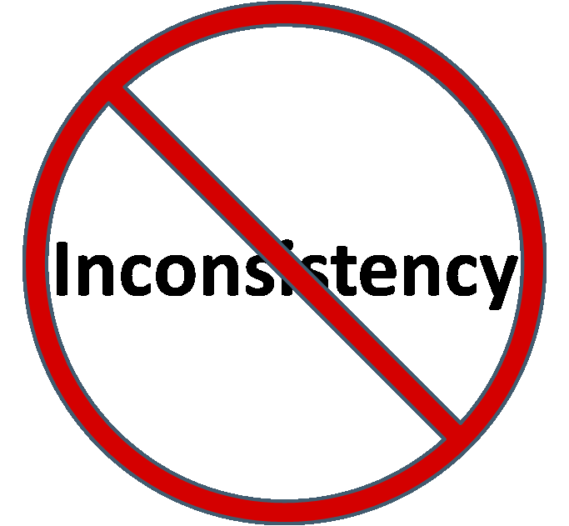
Notes:
What am I looking to achieve? Very simple. Across the country we must limit inconsistency. This guideline is no different from any other DOJ guidelines and the method that I want you to accept and get your mind around, there is a lack of consistency which is causing tremendous problems in the defense of law enforcement. Particular in the core areas.

Slide 12

Deliberate Indifference
Deliberate indifference is demonstrated when the “inadequacy is so obvious, and . . . so likely to result in the violation of constitutional rights, that the policymakers . . . can reasonably be said to have been deliberately indifferent[.]”
  A choice made from among various alternatives;
  A knowing choice, usually made with some state of mind;
  A choice made with some knowledge or
    appreciation of what the consequences
    of the choice will/might be.
Notes:
What does this mean for me and why should I care? You should care because the legal threshold is deliberate indifference.
The question to you Chief is if the DOJ issues a report with some guidelines and everyone is requesting that you do a self assess, is the fact that you don’t do that self assess deliberate indifference? Is it…

Slide 13
Authority
The Violent Crime Control and Law Enforcement Act of 1994
42 U.S.C §14141
It is unlawful for state or local law enforcement officers to engage in a “pattern or practice” of conduct that deprives persons of rights protected by the Constitution or laws of the United States.
Notes:
So lets talk about where the authority comes from. This was put into effect in 1994, post Rodney King incident in order to give the DOJ the ability to review dept for pattern and practice.

Slide 14
42 U.S.C § 14141
Quote from Steubenville Auditor’s Report – 1998
“The provisions of the decree are consistent with prevailing police practices and standards in the United States; therefore serve as a guide to assist the City with the development of policies, practices and procedures that are consistent with contemporary policing requirements.”
Notes:
What does that mean for us and why do I care?
Those that have listened to us in the past know that we always recommend that we pay attention to where we are getting our policies and models. These documents are the docs that we have to pay attention to.

Slide 15
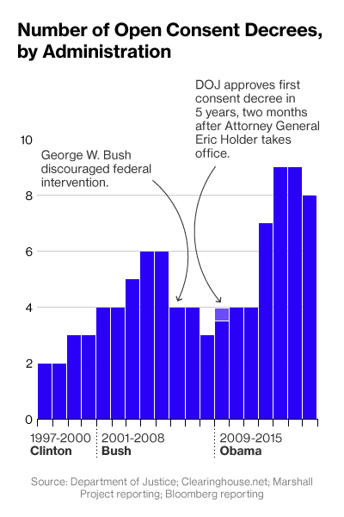
Open Consent Decrees
Notes:
Lets look at whats going on around the country right now.

Slide 16
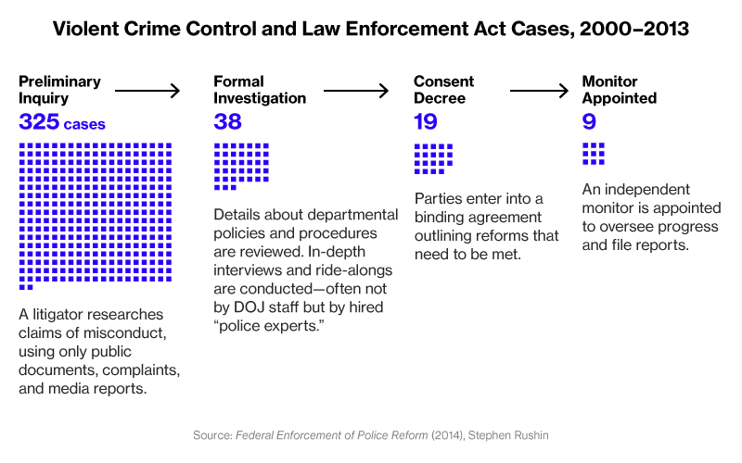
Progression
Notes:
Also talk about the process and how the DOJ does their process. Numbers higher in 2014 and 15.

Slide 17
Task Force on 21st Century Policing
On December 18, 2014, President Obama signed an Executive Order creating the President’s Task Force on 21st Century Policing.
The Mission: identify best practices and otherwise make recommendations to the President on how policing practices can promote effective crime reduction while building public trust.

Slide 18

Task Force on 21st Century Policing:
Final Report (May 2015)

Slide 19
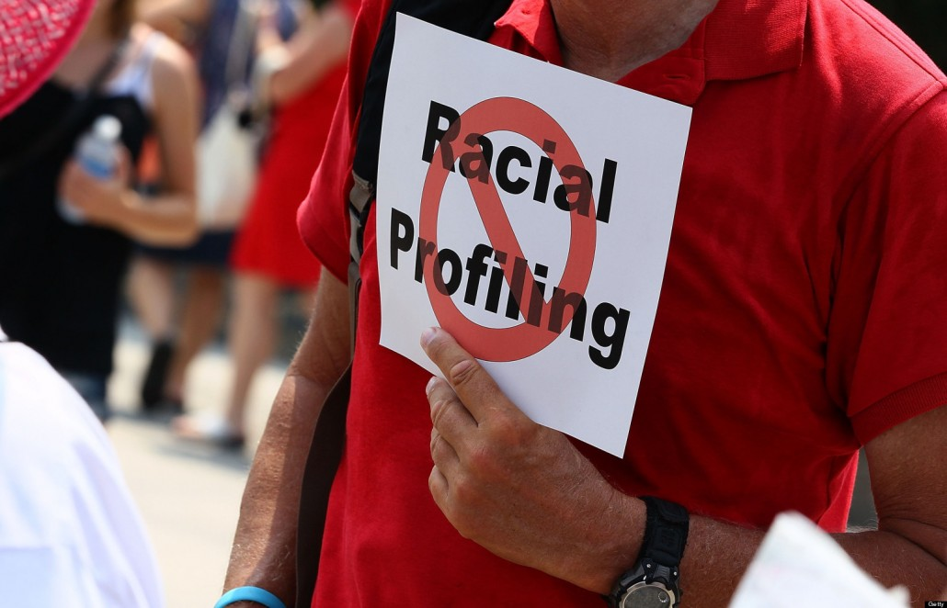
Bias Based Policing
Notes:
First issue brought up in FPD report.

Slide 20
Introduction
After several high profile allegations of racial profiling in the 1990s, many law enforcement practitioners and academics made a concerted effort to better understand and address bias-based policing behavior, and to change perceptions among those in the community that resulted from that behavior.
Have we returned to the 1990’s again?
Notes:
I am an evidence guy and you should be to. Meaning what is the empirical evidence to show that there is such a thing as BBP. Yes each of us should be committed to ensuring that our pd is in line with BBP. Increase in policy and training on this topic for purpose of making our officers better. Hot topic. Reality is that Im concerned that proving that BBP exists is difficult.

Slide 21
Myth or Legend
“Profiling” = a household word
Compelling evidence of a media-driven myth
Even police dogs who are color blind are being accused of racial motivation
No appellate confirmation of any actual law enforcement racial profiling
Actual & Perceived Bias - VIDEO
Notes:
Profiling is a household word. I am a simple person so I ask a simple question: what does that mean? Give me a definition. This is something that needs to be clarified. Compelling evidence suggests that profiling is a media driven myth. What I mean by that is we have evidence that suggests that police dogs have been accused of racial bias. No appellate but maybe lower courts?

Slide 22
Federal Discrimination Laws
Title VI of the Civil Rights Act: Prohibits discrimination based on race, color and national origin in programs and activities receiving federal financial assistance.
Age Discrimination Act: Provides that no person, on the basis of age, shall be excluded from participation in, be denied the benefits of, or be subjected to discrimination under, any program or activity receiving federal financial assistance.
Notes:
Title VI: applies if obtaining federal aid (including use of FBI NCIC system, obtaining training, financial benefits from Omnibus Crime Control and Safe Streets Act of 1968).

Slide 23
Federal Discrimination Laws
ADA, Title II: Prohibits discrimination on the basis of a disability by public entities in providing accommodations and services.
14th Amendment – EPC: Prohibits states from denying any person within its jurisdiction the equal protection of the laws.
42 U.S.C. § 1983: Prohibits the deprivation of any federal right, privilege or immunity under color or law.
Notes:
14 Amendment – EPC: race, national origin, alienage (SS); Age (IS); Rest (RB)

Slide 24
Bias-Based Policing
Bias-based policing is the intentional practice by an individual law enforcement officer who incorporates prejudicial judgments based on race, ethnicity, gender, sexual orientation, economic status, religious beliefs, or age that are inappropriately applied in the performance of his/her duties.

Slide 25
Bias-Based Policing
Bias-Based Policing is Unlawful
Selective enforcement or non-enforcement of the law, including the selecting or rejecting of particular policing tactics or strategies, based on membership in certain demographic categories.
Bias-Free Policing is Lawful
Using membership in a demographic category as part of a reliable suspect-specific description.
Everything that is not bias-based policing.

Slide 26
Whren v. U.S., 517 U.S. 806 (1996)
Officers patrolling “high drug area.”
Observed youths in vehicle with temporary plates; driver looking down at lap of passenger; stopped at intersection for than 20 seconds.
When police make U turn, the vehicle turned without signaling and sped off.
Officers stop vehicle and observe 2 bags of crack.

Slide 27
Whren v. U.S., 517 U.S. 806 (1996)
Issue: whether subjective intentions or objective standards should be used to determine whether stop was constitutionally valid.
Alleged pre-textual stop (defendants were African American).
Defendants argue – technical violations used to investigate other violations → Test should be whether officer, acting reasonably, would have made the stop for the reason given.
Notes:
Defendants argue that “the use of automobiles is so heavily and minutely regulated that total compliance with traffic and safety rules is nearly impossible, a police officer will almost invariably be able to catch any given motorist in a technical violation. This creates the temptation to use traffic stops as a means of investigating other law violations, as to which no probable cause or even articulable suspicion exists. Petitioners, who are both black, further contend that police officers might decide which motorists to stop based on decidedly impermissible factors, such as the race of the car's occupants. To avoid this danger, they say, the Fourth Amendment test for traffic stops should be, not the normal one (applied by the Court of Appeals) of whether probable cause existed to justify the stop; but rather, whether a police officer, acting reasonably, would have made the stop for the reason given.

Slide 28
Whren v. U.S., 517 U.S. 806 (1996)
An investigating law enforcement officer’s ulterior motive is not relevant to the determination of whether a stop or arrest is constitutional under the 4th Amendment.
As long as the officers had p/c of a traffic violation, the stop was “reasonable.”

Slide 29
Whren v. U.S., 517 U.S. 806 (1996)
The 14th Amendment “prohibits selective enforcement of the law based on considerations such as race.”
The Court held that the appropriate constitutional provision to challenge racially based selective enforcement is the EPC, rather than the 4th Amendment.
Notes:
We of course agree with petitioners that the Constitution prohibits selective enforcement of the law based on considerations such as race. But the constitutional basis for objecting to intentionally discriminatory application of laws is the Equal Protection Clause, not the Fourth Amendment. Subjective intentions play no role in ordinary, probable cause Fourth Amendment analysis.

Slide 30
Whren v. U.S., 517 U.S. 806 (1996)
Equal protection – sole standard in determining whether there has been unconstitutional selective enforcement.
Subjective motivations not controlling for purposes of determining whether stops are constitutional under the 4th Amendment.
EP standard requires proof of discriminatory intent to establish a racial profiling claim.

Slide 31
Equal Protection Violations
2 TYPES:
  A law or policy contains an express racial classification that singles out members of the person’s race for disfavored treatment; or
  A facially neutral law or policy was selectively enforced against members of the defendant’s race in an intentionally discriminatory manner. ***

Slide 32
Selective Enforcement Claims
2 Elements:
  The challenged police action was motivated by a discriminatory purpose; and
  The challenged police action had a discriminatory effect on a racial group to which the individual belongs.

Slide 33
Selective Enforcement Claims
Discriminatory Purpose:
  officer selected a particular course of action because of its effect on an identifiable group.
  it is sufficient to show that “a discriminatory purpose has been a motivating factor” in the challenged action.
  Evidence of unequal treatment alone, without at least circumstantial evidence of discriminatory purpose, will not be sufficient to establish an equal protection violation.
Notes:
The discriminatory purpose requirement does not require defendants to prove that race was “the sole, predominant, or determinative factor in a police enforcement action.”
Nor must the defendant show that the discrimination was based on “ill will, enmity, or hostility
Generally, evidence of unequal treatment alone, without at least circumstantial evidence of discriminatory purpose, will not be sufficient to establish an equal protection violation.
The failure of police to avoid or avert unequal treatment is not sufficient to establish discriminatory purpose.
Additionally, when based on considerations other than race, ethnicity, or other impermissible factors, selectivity in enforcement is not unlawful.
A showing of discriminatory intent is sometimes made with direct evidence that law enforcement decisions were based on the defendant’s race, such as an officer’s admission that he approached the defendant because he was a young black male on a street corner who fit the profile of a drug dealer. More typically, however, discriminatory intent is shown through circumstantial evidence.
In some cases, “stark” statistical evidence of a racially disparate impact may be sufficient to prove the discriminatory intent element of an equal protection claim.
While statistical evidence showing that an officer stops, searches, or arrests a disproportionate number of minorities may not suffice alone to show discriminatory intent, discriminatory purpose may be demonstrated with some combination of the following direct, statistical, and circumstantial evidence:

Slide 34
Selective Enforcement Claims
Discriminatory Effect:
  Police action has a “racially discriminatory effect when members of a protected racial group . . . receive less favorable treatment than nonmembers.”
  Look to statistics

Slide 35
Objectives
Hardest part is identifying the conduct
Strict Policies using practices in the industry and lessons learned.
  East Haven, Newark, New Jersey State Police, Prince Georges County
Educating law enforcement on discriminatory policing.
Effective and proper collection and analysis of data.
Educate society about police operations
Notes:
Consent decrees with BBP language. Focus on what did they look at and what did they utilize to support the allegations and what the argument they used to support those allegations? So from the self assessment POV, what should we take from this? We should pay attention to…Educating…
Collection and analysis of data. Big concerns. Not focused on coming to conclusions based on the amount of one specific race that the officer stops. I like to look at the searches, type of people, recovery rate, etc.

Slide 36
Recommendations
The development of a comprehensive policy and procedure for bias free policing is necessary to ensure constitutional policing within a department.
A proper policy clarifies for officers the meaning of the term “bias based policing,” and those actions and behavior that fall within its meaning.
The policy must further outline and identify the department standards and procedures put in place to prevent this type of conduct.
Notes:
The DOJ found that Ferguson’s approach to law enforcement both reflects and supports racial bias. The harms of the Ferg core practices were borne primarily by African Americans who were discriminated against on the basis of race. As a result, DOJ made findings and recs. These are those recs.
…
Officers can understand the law and want to know the standards. Explain it to them.

Slide 37
The DOJ Recommended:
Provide initial and recurring training to all officers that sends a clear, consistent and emphatic message that bias-based profiling and other forms of discriminatory policing are prohibited.
Training should include:
  Relevant legal and ethical standards
  Information on how stereotypes and implicit bias can infect police work
  The importance of procedural justice and police legitimacy on community trust, police effectiveness, and officer safety
  The negative impacts of profiling on public safety and crime prevention

Slide 38
The DOJ Recommended:
Provide training to supervisors and commanders on detecting and responding to bias-based profiling and other forms of discriminatory policing.
Include community members from groups that have expressed high levels of distrust of police in officer training.
Take steps to eliminate all forms of workplace bias from FPD and the City.
Notes:
I recommend that this is a part of your early warning / intervention system. If youre looking at stop data and search results recovery rates you should be discussing this with supervisors to figure out reasons behind data.
Not only application of BBP but also sexual harassment, workplace harassment policy.

Slide 39
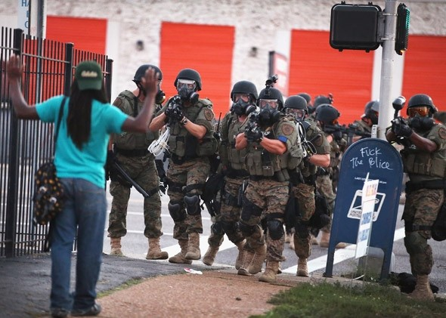
Use of Force:
Reporting & Investigation
Notes:
Again this is a big area and a hot button issue. Lets look at some of the major issues.

Slide 40

What’s Real?

Slide 41
Ferguson Report
To ensure that officers remain within the parameters of their authority to use force, departments must require officers to document all use of force incidents in a timely, complete, and accurate manner, and require supervisors to conduct a thorough review of each use of force incident.
Proper use of force reporting and investigation acts as an early intervention system to detect patterns and trends, allows departments to rectify any problems or issues that are discovered during the review process, and determine the need to revise policies and conduct additional training.
Notes:
Every department has the ability to become Ferguson, just need perfect storm. Three things: real bad incident attracts a lot of attention; everyone commenting on the issue and bias; POTUS gives opinion. Should use independent force investigations.

Slide 42
Ferguson Report
Instituting a proper use of force reporting and investigation system provides protection to both citizens and employees, and demonstrates the department’s commitment to documenting and investigating all use of force incidents.

Slide 43
DOJ Recommended
Develop and implement supervisory review of force that requires the supervisor to conduct a complete review of each use of force, including gathering and considering evidence necessary to understand the circumstances of the force incident and determine its consistency with law and policy, including statements from individuals against whom force is used and civilian witnesses.

Slide 44
DOJ Recommended
Prohibit supervisors from reviewing or investigating a use of force in which they participated or directed.
Discipline any officer who fails to report a use of force, as well as any supervisor who fails to conduct adequate force investigations.

Slide 45
Force Review
The DOJ also recommended that the FPD implement a system of force review that ensures that improper force is detected and responded to effectively, and that policy, training, tactics, and officer safety concerns are identified.

Slide 47
Purpose of Use of Force Reporting
Establishes the foundation for use of force justification and investigation.
  A instrument used by officers to explain and justify the reason for the use of force in a particular situation
  Provides the agency with timely information concerning use of force incidents
Supervisors
  A means to ensure compliance with use of force policy through a post-incident evaluation of an officer’s actions

Slide 48
Purpose of Use of Force Reporting
Early Intervention Systems
  Use of force is a key performance indicator that is used to identify at-risk officers and correct problematic behaviors.
Training Components
  Use of force documentation can be utilized to enhance officer learning based on an evaluation of reports describing field incidents.

Slide 49
Purpose of Use of Force Reporting
Use of force data is used to identify patterns or trends that may indicate training needs equipment upgrades, and/or policy modifications.
  Whether certain officers use more force than others?
  What kinds of force are being used?
  Under what circumstances officers use force?
  Frequency of the use of force?
  Officer / civilian injury resulting from the use of force?

Slide 50
Purpose of Use of Force Reporting
Lawsuits / Community Support
  Critical that departments ensure and be able to document that its officers employ only that level of force that is reasonably necessary to control a situation.
  Agencies are in a much better position to defend themselves against charges of excessive force if they document the types of situations in which your officers have used force.

Slide 51
Supervisory Response
When the Supervisor is notified of use of force he or she shall respond on a priority basis and do the following:
  Conduct a preliminary investigation into the use of force.
  Document, as necessary, the scene of the incident.
  Shall visibly inspect the officer(s) and subject(s) for injury.
  Interview the subject for complaints of pain, and ensure that the subject receives needed medical attention.

Slide 52
Force Investigation Requirements
Per Level
Level Two
Hard Hands
Chemical Agent
Impact Weapon
ECW
Supervisory Response
Officer Interview
Suspect Interview
Medical Attention
Photograph
Evidence
Witnesses
Level One
Soft Hands
Escort
Dispatch of Animal
No Response
Report
Review
Level Three
Serious Injury
OIS
In-custody Death
Supervisor
Hold scene
Evidence
Public Safety Statement

Slide 53
Supervisory Response
The Supervisor shall identify and interview witnesses other than officers as appropriate.
The Supervisor shall interview any physician or qualified health care provider concerning the injuries sustained and their consistency with uses of force reported;
The Supervisor shall take video/ audio statements from all officers who participated in or witnessed the event as appropriate within (5) five working days of the reportable use of force.

Slide 54

Force Evaluation
Not a rubber stamp process

Slide 55
Force Evaluation
The Supervisor shall obtain and review the Use of Force Report, evaluate the force used by the officer, and sign the completed Use of Force Report from each officer prior to the end of the tour of duty.
The investigating supervisor shall forward the report to the patrol commander, who shall review the report to ensure that it is complete and that the findings are supported by a preponderance of the evidence.
Shall find “within” or “not within policy”

Slide 56
Supervisor Narrative
The supervisor narrative must include a precise description of the facts and circumstances that either justify or fail to justify an officer’s conduct.
The supervisor must consider all relevant evidence including circumstantial, direct, and physical evidence.
The supervisor must summarize his or her investigation and findings.

Slide 57
Supervisor
The supervisor shall ensure that all reports include contemporaneous photographs or videotapes taken of all injuries at the earliest practicable opportunity, both before and after treatment.
The supervisor shall make credibility determinations and make all reasonable efforts to resolve material inconsistencies between witness statements.

Slide 58

Supervision

Slide 59
It All Starts with Supervisors
Shall ensure that supervisors have the knowledge, skills, and ability to provide close and effective supervision to each officer under the supervisor's direct command; provide officers with the direction and guidance necessary to improve and develop as police officers; and to identify, correct, and prevent officer misconduct.

Slide 60

Supervision
“The agency is only as strong
as the weakest sergeant”

Slide 61
DOJ Recommendation:
Require supervisors to review all officer activity and review all officer reports before the supervisor leaves shift;
Provide all supervisors with specific supervisory training prior to assigning them to supervisory positions;
Develop and require supervisors to use an “early intervention system” to objectively detect problematic patterns of officer misconduct, assist officers who need additional attention, and identify training and equipment needs;

Slide 62
DOJ Recommendation:
Support supervisors who encourage and guide respectful policing and implement community policing principles, and evaluate them on this basis. Remove supervisors who do not adequately review officer activity and reports or fail to support, through words or actions, unbiased policing;
Ensure that an adequate number of qualified first-line supervisors are deployed in the field to allow supervisors to provide close and effective supervision to each officer under the supervisor’s direct command, provide officers with the direction and guidance necessary to improve and develop as officers, and to identify, correct, and prevent misconduct.

Slide 63
Best Practices - Supervisors
A
Acquire knowledge of policies, procedures and the law.
C
Control, monitor & train subordinates.
T
Take appropriate action if subordinates fail to follow P&P and law.

Slide 64
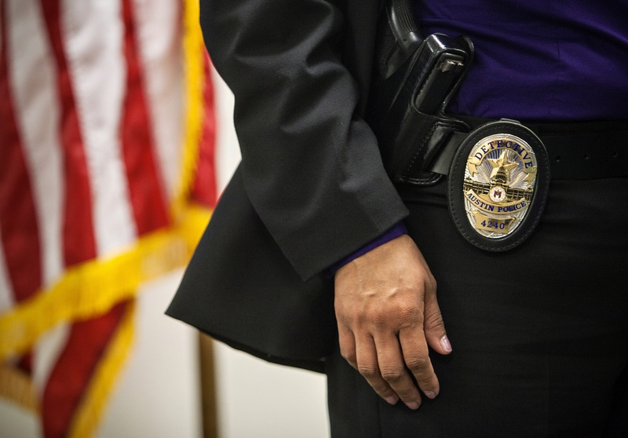

Accepting & Investigating Complaints of Misconduct

Slide 65
Complaints of Misconduct
Establishing a policy for accepting and investigating citizen complaints is essential to ensure that Departments accept all complaints of misconduct, in any form; fairly and impartially investigate all complaints of misconduct; and timely impose any disciplinary or non-disciplinary corrective actions that may be warranted.
The DOJ report provided that “responding to allegations of officer misconduct is critical not only to correct officer behavior and identify policy, training, or tactical concerns, but also to build community confidence and police legitimacy.”

Slide 66
DOJ Recommended:
Modify procedures and practices for accepting complaints to make it easier and less intimidating for individuals to register formal complaints about police conduct, including providing complaint forms online and in various locations throughout the City and allowing for complaints to be submitted online and by third parties or anonymously;
Require that all complaints be logged and investigated;

Slide 67
DOJ Recommended:
Develop and implement a consistent, reliable, and fair process for investigating and responding to complaints of officer misconduct, including:
  An investigation of all misconduct complaints, even where the complainant indicates he or she does not want the complaint investigated, or wishes to remain anonymous;
  Not withdrawing complaints without reaching a disposition
  Developing and implementing a fair and consistent system for disciplining officers found to have committed misconduct
  Terminating officers found to have been materially untruthful in performance of their duties, including in completing reports or during internal affairs investigations

Slide 68
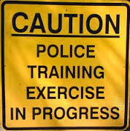
Training

Slide 69
Training
Officer training is essential to ensure that officers understand the policies and procedures that have been put in place; to identify the legal standards applicable to the policies; and specify the actions and behaviors necessary to conform to the standards.
The United States Supreme Court has repeatedly held that a police department has a duty to train its officers on core tasks that the officers are required to complete.

Slide 70
DOJ Recommended:
Train and require officers to use de-escalation to avoid a situation escalating to a use of force;
Require that training cover, in depth, constitutional and other legal restrictions on officer action, as well as additional factors officers should consider before taking enforcement action (such as police legitimacy and procedural justice considerations);
Employ scenario-based and adult-learning methods.

Slide 71
Failure to Train
The plaintiff must identify the particular deficiency in the training program of the Police Department or how that alleged deficiency caused his injury.
The alleged deficiency in the training must be closely related to the alleged injury.
Notes:
any particular deficiency in the training program of the Hartford Police Department or how that alleged deficiency caused his injury. See City of Canton v. Harris, 49 U.S. 378, 391, 109 S.Ct 1197, 1206 (1989). The alleged deficiency in the training must be closely related to the alleged injury. Id. at 391, 109 S.Ct. at 1206. To require less of a standard would result in de facto respondeat superior liability, a result specifically rejected in Monell.

Slide 72
City of Canton v. Harris
389 U.S. 378 (1989)
Held: Municipalities have an affirmative duty to train employees in core tasks.
Inadequate law enforcement training may form the basis for a civil rights claim where the failure to train amounts to deliberate indifference to the rights of persons whom the police come into contact with.

Slide 73
City of Canton v. Harris
389 U.S. 378 (1989)
  The focus must be on the adequacy of a training program in relation to the duties the officers are expected to perform and the identified deficiency, in a city’s training program.
  This will occur when the need for more or different training is so obvious, and the inadequacy so likely to result in the violation of constitutional rights, that the policymakers of the city can reasonably be said to have been deliberately indifferent to the need.

Slide 74
Training
Policy is only as effective as the training in the substance and requirements of that policy. If training is weak, unfocused or nonexistent, then the policy will not be followed.
Once policy is issued- Training must occur in the substance of that policy.
Policy distribution and tracking – PowerDMS
Recommended method is hypothetical scenarios that would indicate the policy.

Slide 75
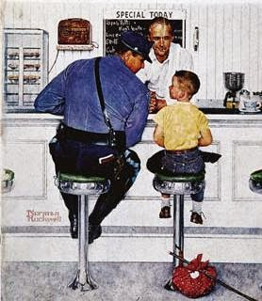
Community Policing

Slide 76
Community Policing
Research provides that community policing creates and promotes an environment of trust between police officers and the citizens they are sworn to protect and serve.
Community members who have frequent positive interactions with police officers feel a greater degree of safety within their communities, and are left with a greater level of confidence in the police department.
By nurturing a policy of community policing, police departments develop a partnership with its citizens for the identification and prevention of crime.

Slide 77
DOJ Recommended:
Develop and put into action a policy and detailed plan for comprehensive implementation of community policing and problem-solving principles. Conduct outreach and involve the entire community in developing and implementing this plan;
Increase opportunities for officers to have frequent, positive interactions with people outside of an enforcement context, especially groups that have expressed high levels of distrust of police. Such opportunities may include police athletic leagues and similar informal activities;

Slide 78
DOJ Recommended:
Develop community partnerships to identify crime prevention priorities, with a focus on disconnected areas, such as Ferguson’s apartment complexes, and disconnected groups, such as much of Ferguson’s African-American youth;
Modify officer deployment patterns and scheduling (such as moving away from the current 12-hour shift and assigning officers to patrol the same geographic areas consistently) to facilitate participating in crime prevention projects and familiarity with areas and people;

Slide 79
DOJ Recommended:
Train officers on crime-prevention, officer safety, and anti-discrimination advantages of community policing. Train officers on mechanics of community policing and their role in implementing it;
Measure and evaluate individual, supervisory, and agency police performance on community engagement, problem-oriented-policing projects, and crime prevention, rather than on arrest and citation productivity.

Slide 80
The End…

